Slide 1
Healthy Boards, Thriving Ministries
October 2024
Kevin Ford, Chief Catalyst

Slide 2
What We’ll Cover
Why a healthy board is critical for personal and organizational well-being.
The Leadership Triangle – three modes of board functioning.
What does a Governing Board really do (and not do)?
Items for Your Board to Discuss.
Endowment Funding for a Limited Number of Attentive Church Cohorts through Church United.

Slide 3
Moses Leading the Children of Israel
11 He asked the Lord, “Why have you brought this trouble on your servant? What have I done to displease you that you put the burden of all these people on me? 12 Did I conceive all these people? Did I give them birth? Why do you tell me to carry them in my arms, as a nurse carries an infant, to the land you promised on oath to their ancestors? 13 Where can I get meat for all these people? They keep wailing to me, ‘Give us meat to eat!’ 14 I cannot carry all these people by myself; the burden is too heavy for me. 15 If this is how you are going to treat me, please go ahead and kill me—if I have found favor in your eyes—and do not let me face my own ruin.” Numbers 11-15

Slide 4
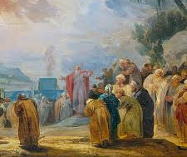
Healthy Boards are Critical for Well-Being
The Lord said to Moses: “Bring me seventy of Israel’s elders who are known to you as leaders and officials among the people. Have them come to the tent of meeting, that they may stand there with you. “I will come down and speak with you there, and I will take some of the power of the Spirit that is on you and put it on them. They will share the burden of the people with you so that you will not have to carry it alone.”
Numbers 11.16-17

Slide 5
Governance
“Effective governance by a board of trustees is a relatively rare and unnatural act . . . . trustees are often little more than high-powered, well-intentioned people engaged in low-level activities” (Chait, Holland, and Taylor). “There is one thing all boards have in common . . . . They do not function” (Drucker). “Ninety-five percent (of boards) are not fully doing what they are legally, morally, and ethically supposed to do” (Geneen). “Boards tend to be, in fact, incompetent groups of competent individuals (Carver).”

Slide 6
What’s the Problem?
Deacons
MOT
Business
Family
Spiritual Community
Elders
Pastors
Oversight Team
MLT
Members

Slide 7
Healthy Boundaries and Soul Care
Boundaries help determine what is and is not okay in a relationship– whether that be with friends, partners, co-workers, bosses, or family members. Ideally, we put them in place to protect our well-being. They help us to build trust, safety, and respect in relationships.

Slide 8
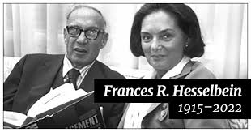
Boundaries Are Essential to Health
“Governance is governance; management is management. Successful organizations sharply differentiate the two.”
Frances Hesselbein, former CEO of the Drucker Institute and Girl Scouts of America

Slide 9
Clear Boundaries Enable Soul Care
Distinguish between Governance as Leadership and Management as Leadership. This is a critical component of soul care of the pastor(s) and staff. Using the terms “leader” or “leadership” is too broad.
Governance is about establishing boundaries (also called policies). Management is about carrying out the work of the ministry within the boundaries.

Slide 10
The Three Roles of a Governing Board
Establish and monitor organizational boundaries, also known as policies.
Model what it means to be a spiritual community for the rest of the church.
Be available for crises.

Slide 11
A Bird’s Eye View
As a church grows, most Boards don’t properly evolve. Working boards need to become Governing Boards. The goals are to:
Create a permission-giving structure that empowers the pastors, staff, and volunteers to carry out the ministry without needing board approvals and decisions at every turn.
Establish policies that protect the church from scandal or abuse.
Clarify the stark differences between the board’s role and management’s role.
Encourage board members, as individuals, to advocate and volunteer for the ministry in the community.

Slide 12
Working Board | Governing Board
Individual board members are volunteers who have individual responsibility and authority to carry out tasks, because the church lacks the resources to hire professional staff. | Board members establish boundaries to protect the organization. The management and staff carry out the tasks within the bounds of the policies.
Collectively, the board is a decision-making body. | Collectively, the board establishes the boundaries. Management and staff make decisions.
The board has multiple committees to carry out the work of the ministry in between board meetings. | By and large, most committees disappear because the work is carried out by staff and volunteers.
The Pastor typically organizes the board meetings, agenda, topics, and board expectations. | The Board Chair is responsible for these activities. The Pastor has no individual responsibility for the board.

Slide 13
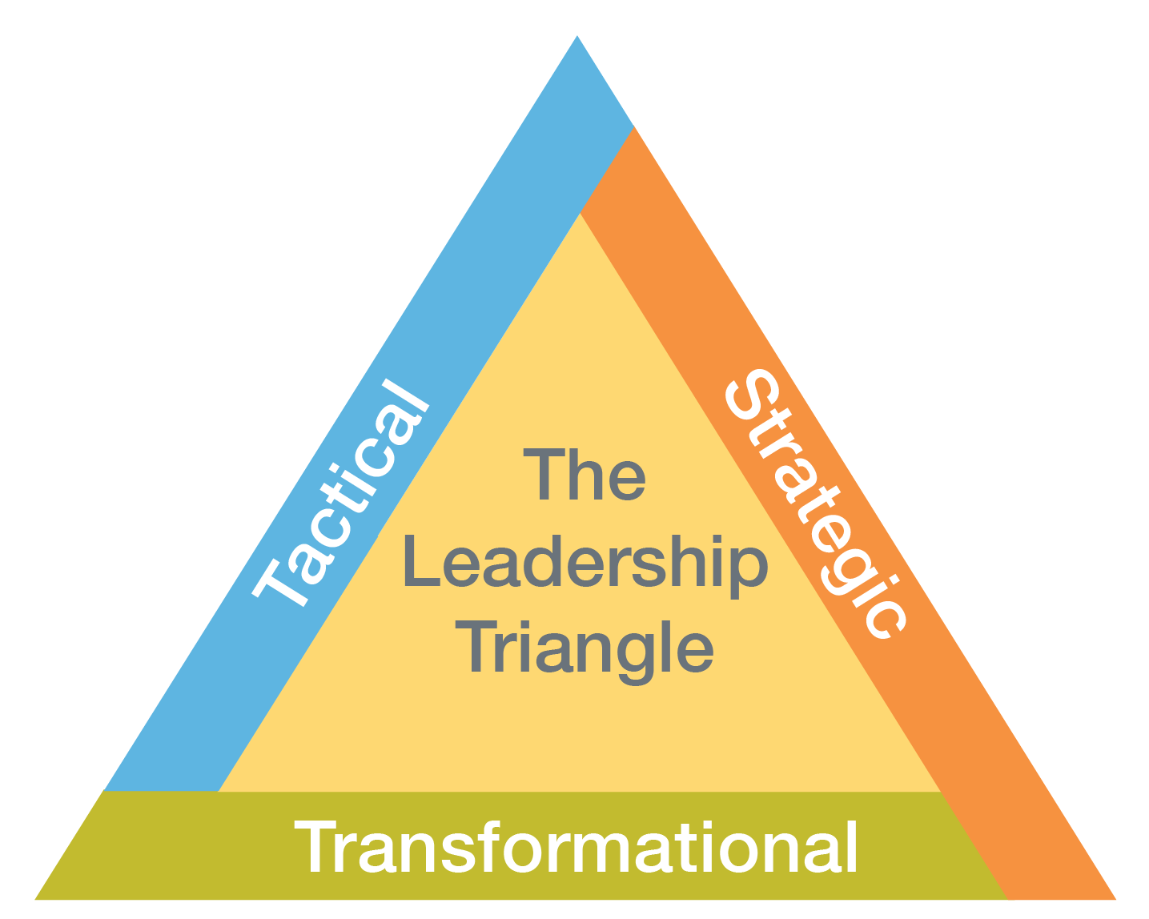
The Leadership Triangle
A Framework for Governance

Slide 14
The Leadership Triangle for Boards
Strategic | Tactical | Transformational
Decisions around Desired Results | Fiduciary | Grief Counseling
Annual Cycle | Protect the Organization | Non-Anxious Presence
Innovative and Generative | Establish Boundaries (Annual Review) | Manage Conflict (Ad Hoc)

Slide 15
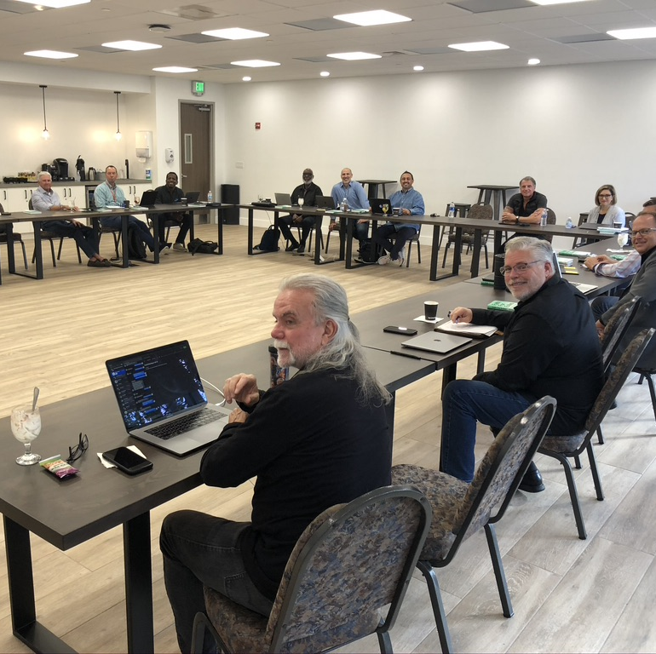
So what does a church board really do (and not do)?

Slide 16
Establish and monitor four categories of boundaries (policies)
Executive Limitations
Governance Process
Board/Staff Linkage
Ends (Desired Results)
Evaluation is based on measuring how well we achieved the ends.

Slide 17
Structures and Meetings Change in this Model
Most committees disappear as the board moves away from “management”;
The long staff reports are gone from meetings;
The boundaries are reviewed on a periodic basis;
Conversations are centered more on strategic and transformational issues;
Desired results are measured.

Slide 18
Ground Rules for Governing Boards
The Board has one employee (Pastor or Executive Pastor);
The Board speaks with one voice, individual members do not have authority; Board Chair speaks on behalf of the Board
The Pastor is not responsible for the Board (training, agenda-setting, etc.), rather the Board is responsible for the Board;
The Board has Executive Session regularly (without the Pastor);
Clear expectations and measurements are key.

Slide 19
Ground Rules for Governing Boards
Expectations and policies replace most approvals and decisions;
Board is responsible for establishing ends; staff is responsible for the means.
Other than by-laws, no other documents are required to govern;
Desired “ends” are stated in the affirmative.
“Means” policies are stated in the negative and apply only to legal, moral, and ethical means.

Slide 20
So, what do we do with all the extra time?
Have strategic conversations.
Grow spiritually.
Enjoy fellowship.

Slide 21

Items for Your Board to Address

Slide 22
Your Next Steps: Clarify These 8 Things
Board’s Role, Purpose, and Authority
Board / Staff Linkage
Committees
Maximizing Strengths
Board Meetings
Board Process
Executive Limitations
Establishing True North

Slide 23
Board’s Role and Purpose
What is the role and purpose of the Board?
What decisions are exclusive to the Board?
What are the limits to the Board’s authority?
Do individual members have individual authority?

Slide 24
Board / Staff Linkage
How can we clearly differentiate the Board Chair and Pastor’s roles?
What decisions and/or directions should be made collaboratively with the staff (management, etc.)?
What decisions are exclusive to the staff?
Who speaks on behalf of the board to the staff, if there is a conflict with the Board Chair?
Who speaks on behalf of the staff to the board, if there is a conflict with the pastor?

Slide 25
Committees
Do we need committees? If so, which ones are essential and which ones are non-essential?
What authority should committees have or not have?
Should board members chair committees, serve another role on committees, or not be on committees?
What should the role of staff members be as it pertains to committees?

Slide 26
Maximizing Strengths
Don Clifton (StrengthsFinder)Identified 34 prevalent talent themes
More than 33 million potential combinations
A great tool for boards and staff teams
To understand how each individual can best contribute to the board;
To become more self-aware (when my greatest strengths become my greatest weaknesses);
To generate better collaboration by understanding differences;
To explain a primary source of conflict (colliding values).

Slide 27
Doug Sauder, Calvary Chapel
Notes:
The Gallup computers actually found between 300 and 400 different talents, which they narrowed down to 34 prevalent themes. The top theme shows up in the top five talents for about 33% of the people in the CoreClarity® database.
The CoreClarity® database currently has almost 6,500 people in it (May 2008), so there are enough data points to be statistically significant. (If you have Analytical people in the group, they will care about knowing this.) The people in the database range from students to executives and everyone in between. The least prevalent theme shows up in less than 5% of the population.
At this juncture, I want to be very clear. At CoreClarity we are very specific about the difference between a talent and a strength. In the name of the assessment and the titles of their books, Gallup uses the terms “talent theme” and “strength” interchangeably. They are not synonymous. The assessment does not measure your strengths, it actually measures your talents. It should have been called “TalentFinder”!
Remember what I said before, you can build 1, 20, 200 and even 2,000 strengths from your base talents. And they can, but will probably not, have the same name as a talent. Additionally, only the individual knows if a talent has become a strength.
There are over 33 million potential combinations of talents.

Slide 28
Board Meetings
How can we improve board meetings so that we allow appropriate time for strategic conversations, fellowship, and teambuilding?
What is the best way to handle staff reports and provide needed information?
How often should the board meet? What is the best rhythm and timing?
How do we provide regular time for board discussions in executive session (without the Pastor)?

Slide 29
Board Process and Expectations
What do we need to look for in new board members (skills, backgrounds, experiences, perspectives, etc.)?
What procedures should we put in place for recruiting new board members?
How can we improve onboarding for new board members?
What process do we need to put in place to evaluate our board functioning on a regular basis?

Slide 30
Executive Limitations
What executive limitations for the Pastor need to be clarified to protect the church?
What happens if executive limitations are breached?

Slide 31
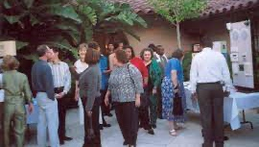
The Attentive Church Process

Slide 32
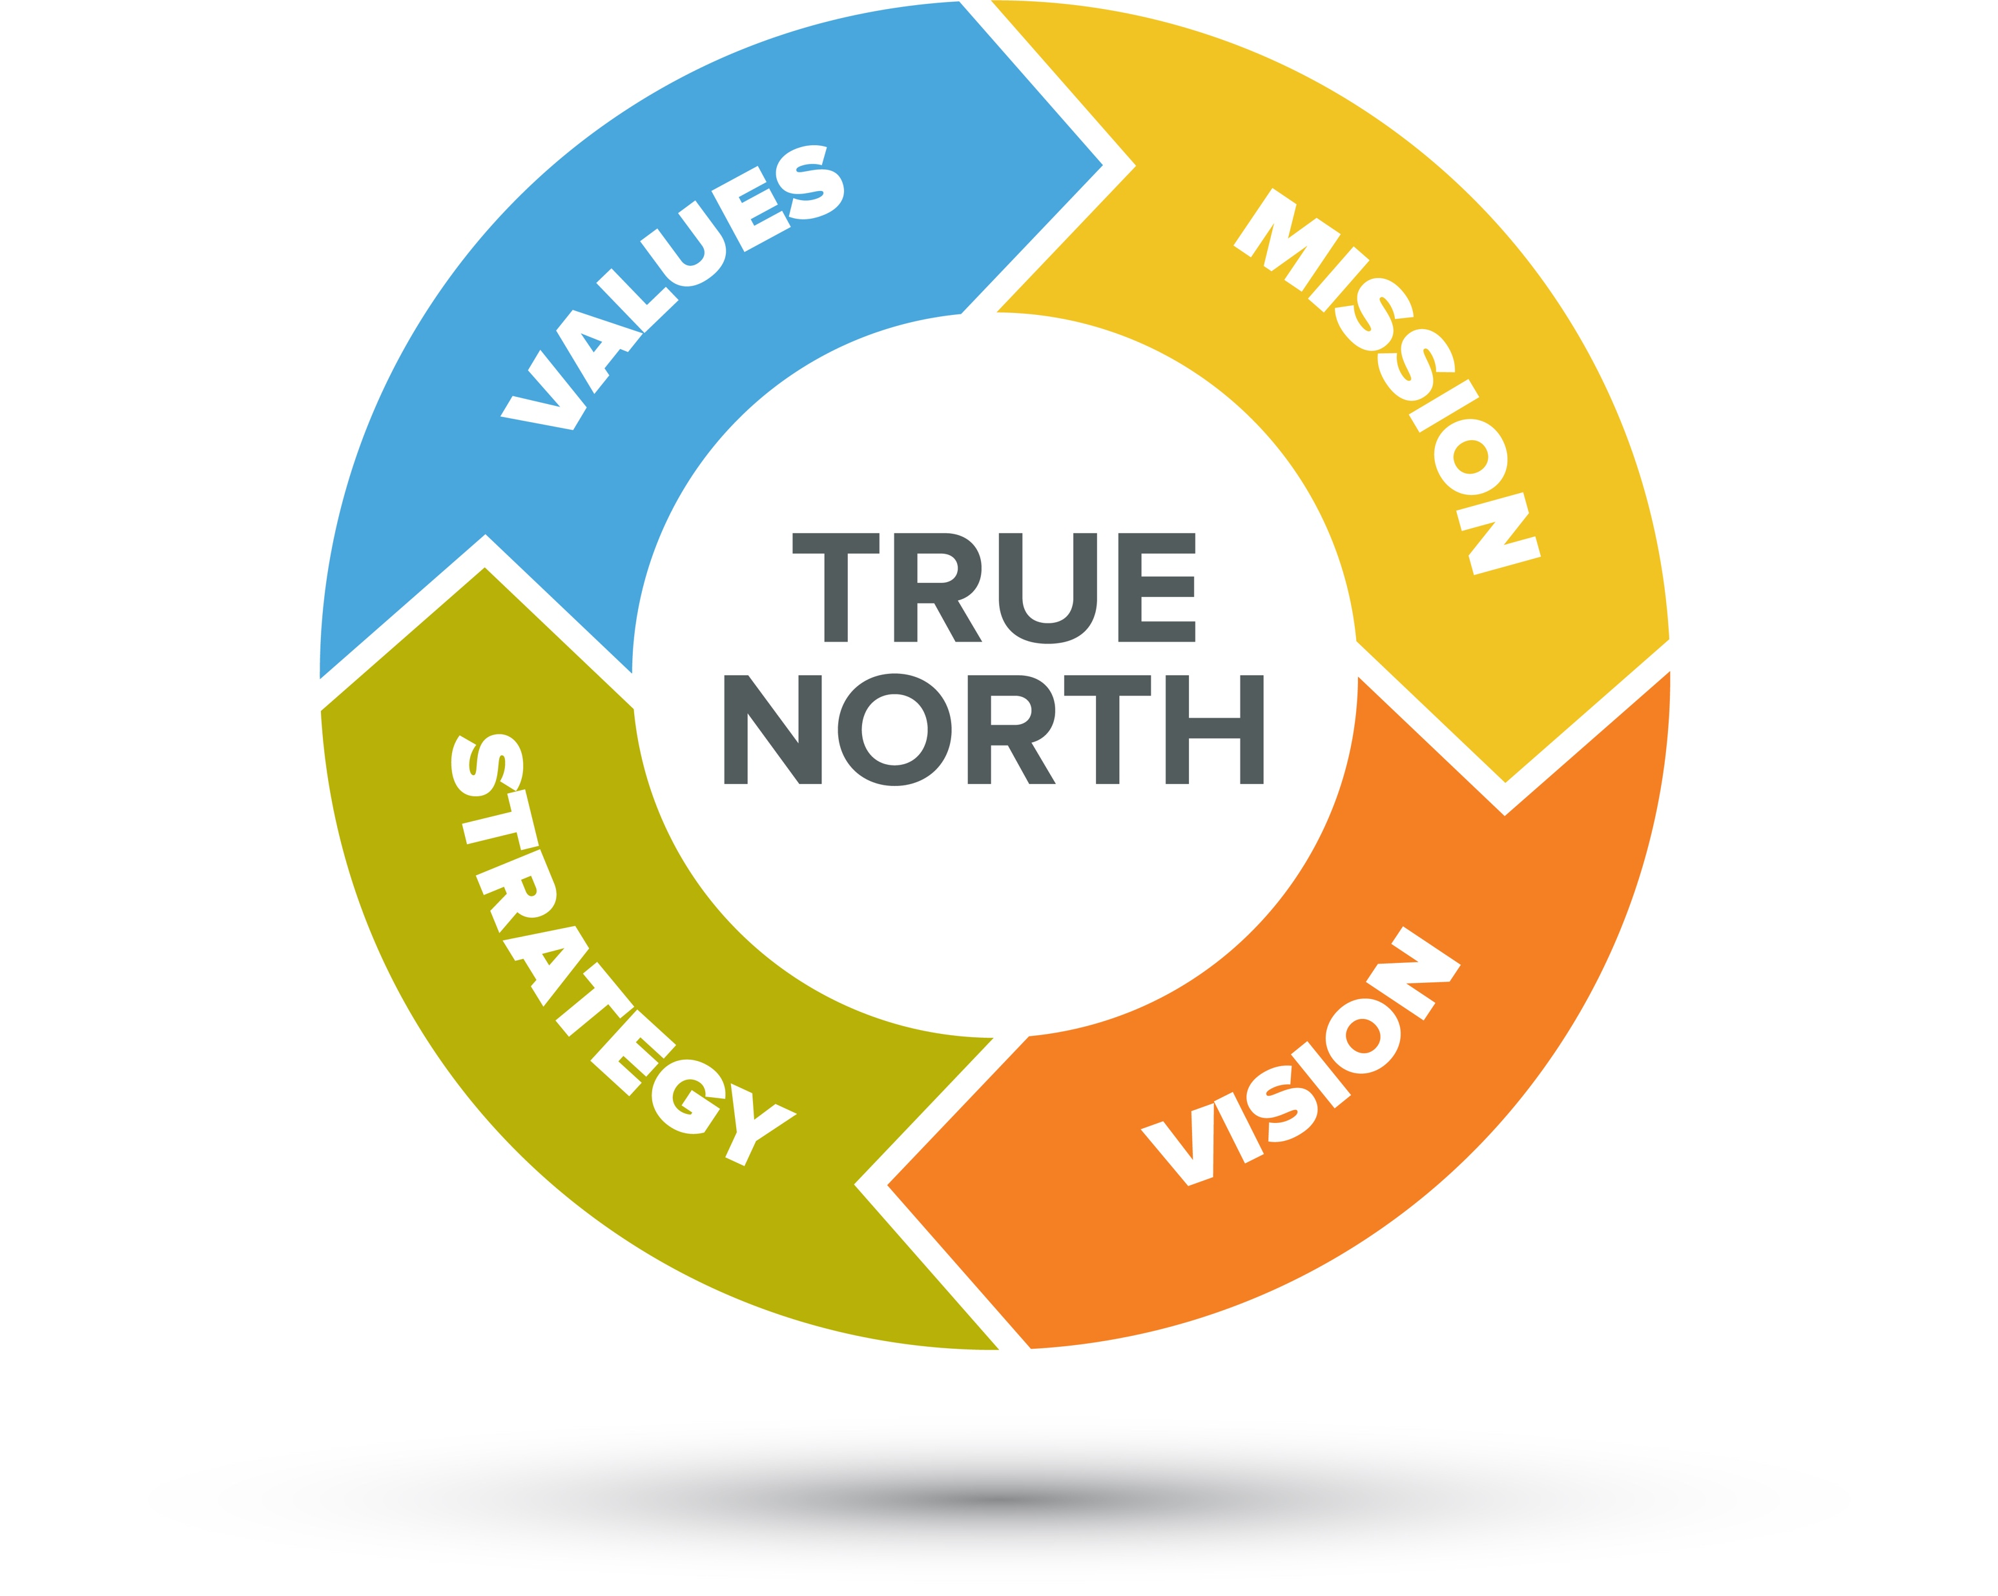
This Journey is about Clarifying True North

Slide 33

Then Aligning Everything to It!

Slide 34
Questions to Consider
Have we effectively established our True North? This should be an ongoing process with regular updates and revisions.
As a Board, how can we ensure that we are using it as our ultimate “ends”?
Management is responsible for alignment (means).

Slide 35
A Limited Time Opportunity
The national endowment has provided Church United with funding to create Attentive Church Cohorts.

Slide 36
Who Can Participate?
Churches within a common geographical area (due to collaborative meetings). Typically 6-8 churches form one cohort.
The churches should have some common goal that they can work on collaboratively.
An eager leadership team, including the pastor, willing to commit to 18 months together.

Slide 37
What Will We Do?
Sixteen Facilitated Cohort Sessions for the Pastors
A Discovery Process for Each Congregation (survey, focus groups, community needs assessment)
Two Visioning Retreats for Leaders!

Slide 38
What Will We Discuss in the Cohort Sessions?
How we can support each other
Real issues and roadblocks at our churches
Discovery process findings
What needs we see in our local communities
How to mobilize and develop our leaders
How to deal with conflict
What are values, mission, and vision should be
How to set strategic priorities

Slide 39
What does it cost?
Normally, a process like this would be $20,000 for an individual congregation. By partnering together, an Endowment is underwriting most of the cost.
Each pastor and facilitator will be paid to participate, including travel expenses for a soul care gathering.
The cohorts will have a few expenses along the way. Most of those costs are simply the cost of gatherings (meals, room set up, etc.). Each church will need to purchase a demographic study of their local community (roughly $150) and the cost of a CoreClarity Assessment for the pastor ($100).
That’s it!

Slide 40
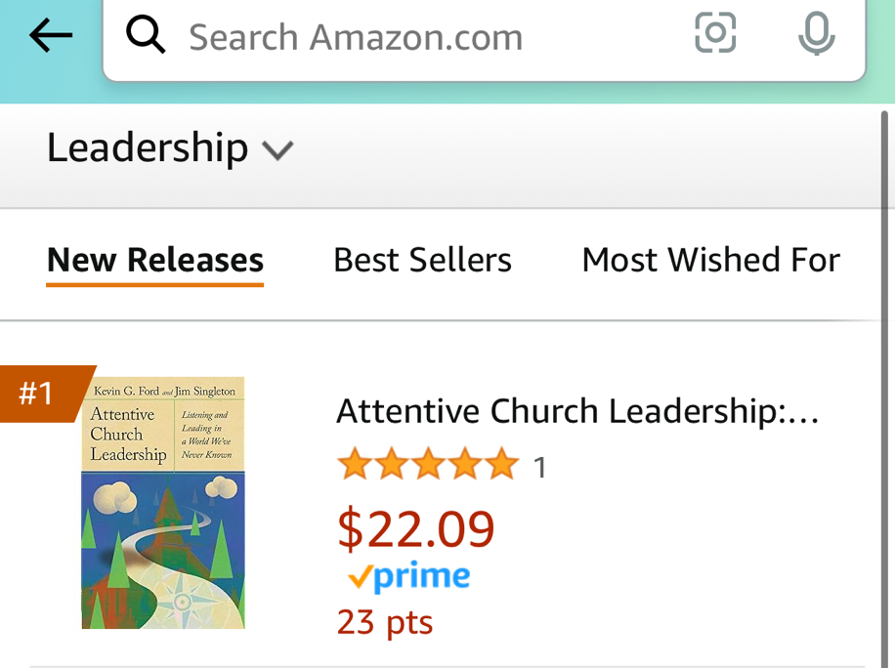
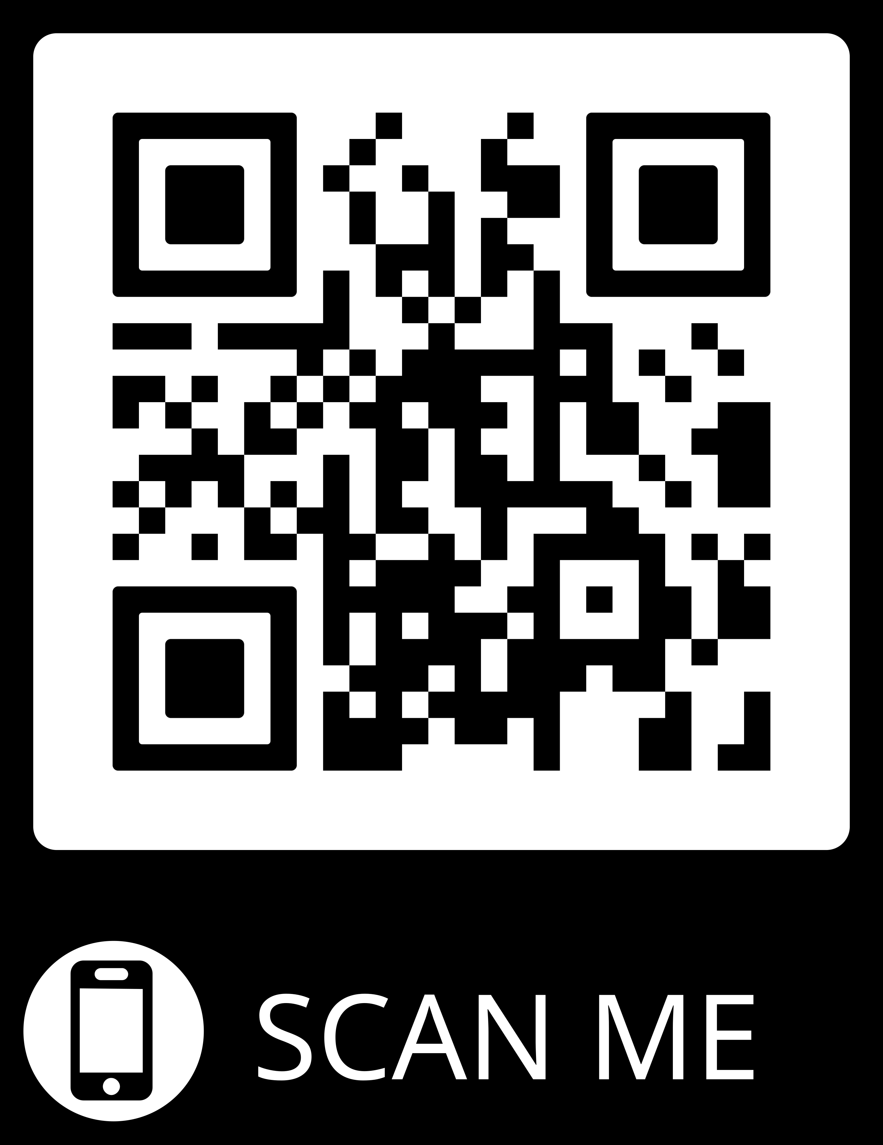
Books, Podcast Subscription, and More!

